Slide 1
Neural Networks

Slide 2
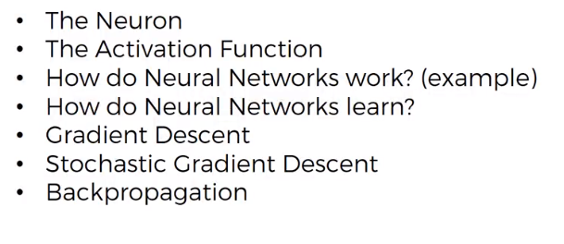
Todays Agenda

Slide 3
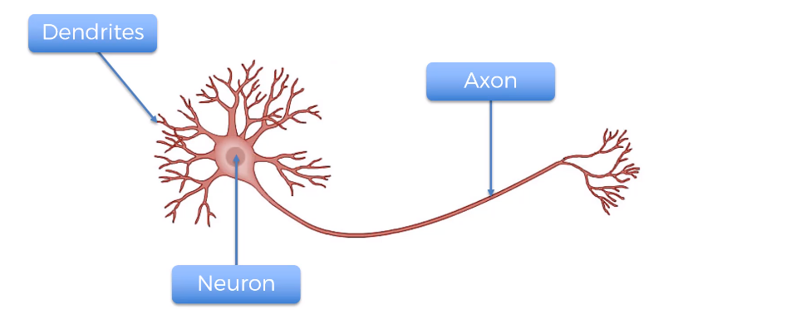
The Neuron

Slide 4
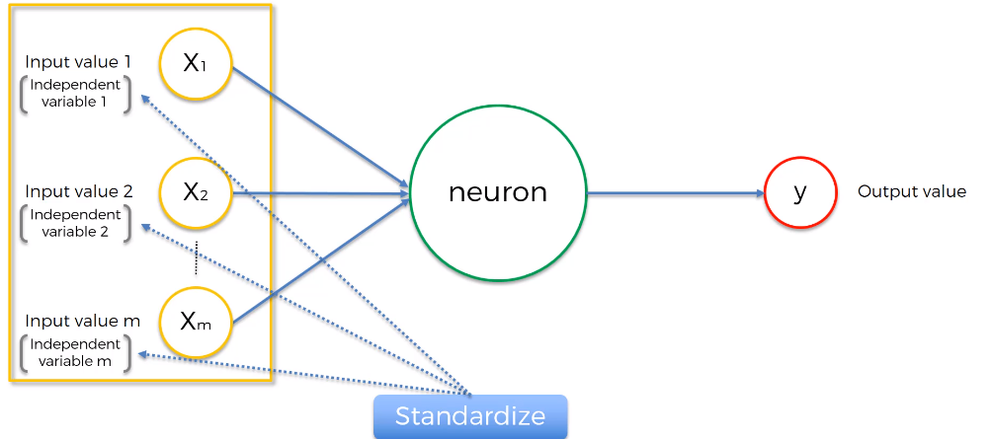
The Neuron

Slide 5
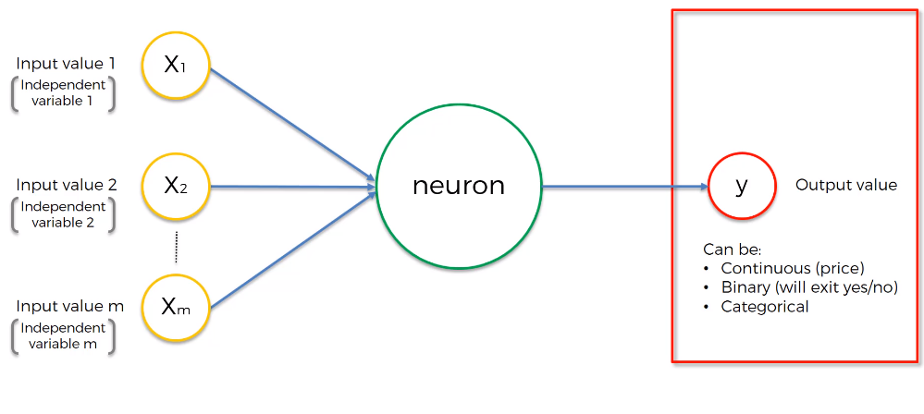
The Neuron
Notes:
For categorical, you will have multiple outputs.

Slide 6
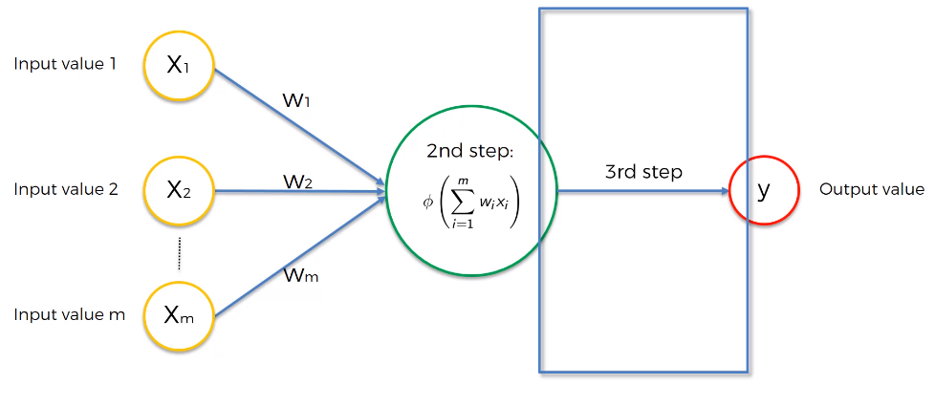
The Neuron
Notes:
For categorical, you will have multiple outputs.

Slide 7
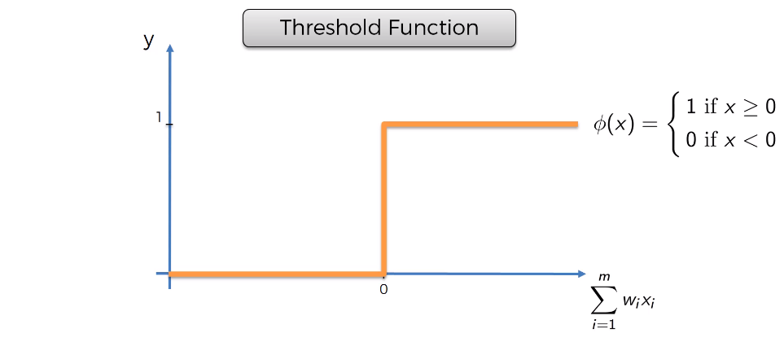
The Activation Function
Notes:
For categorical, you will have multiple outputs.

Slide 8
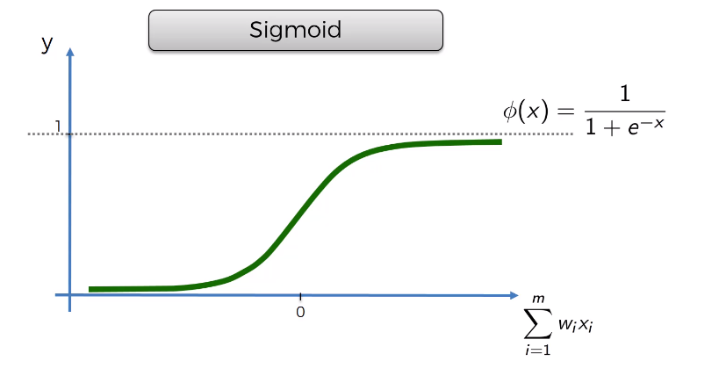
The Activation Function
Notes:
For categorical, you will have multiple outputs.

Slide 9
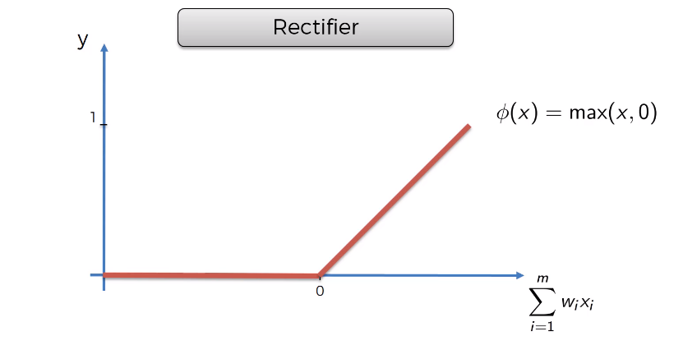
The Activation Function
Notes:
For categorical, you will have multiple outputs.

Slide 10
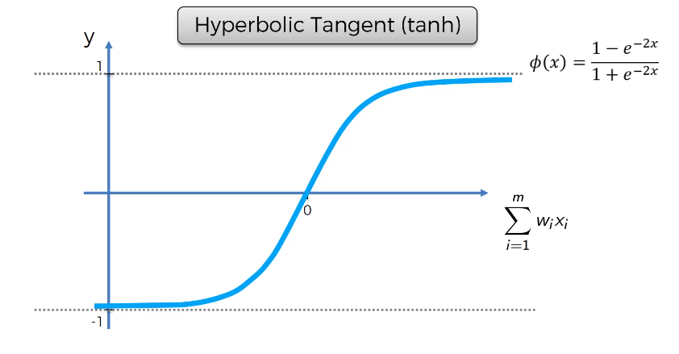
The Activation Function
Notes:
For categorical, you will have multiple outputs.

Slide 11
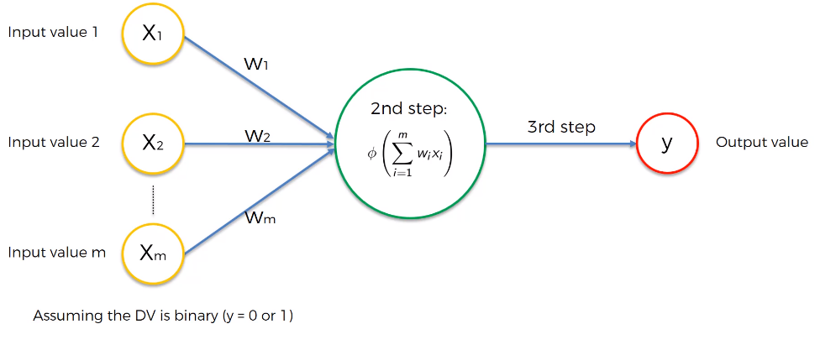
The Activation Function?
Notes:
For categorical, you will have multiple outputs.

Slide 12
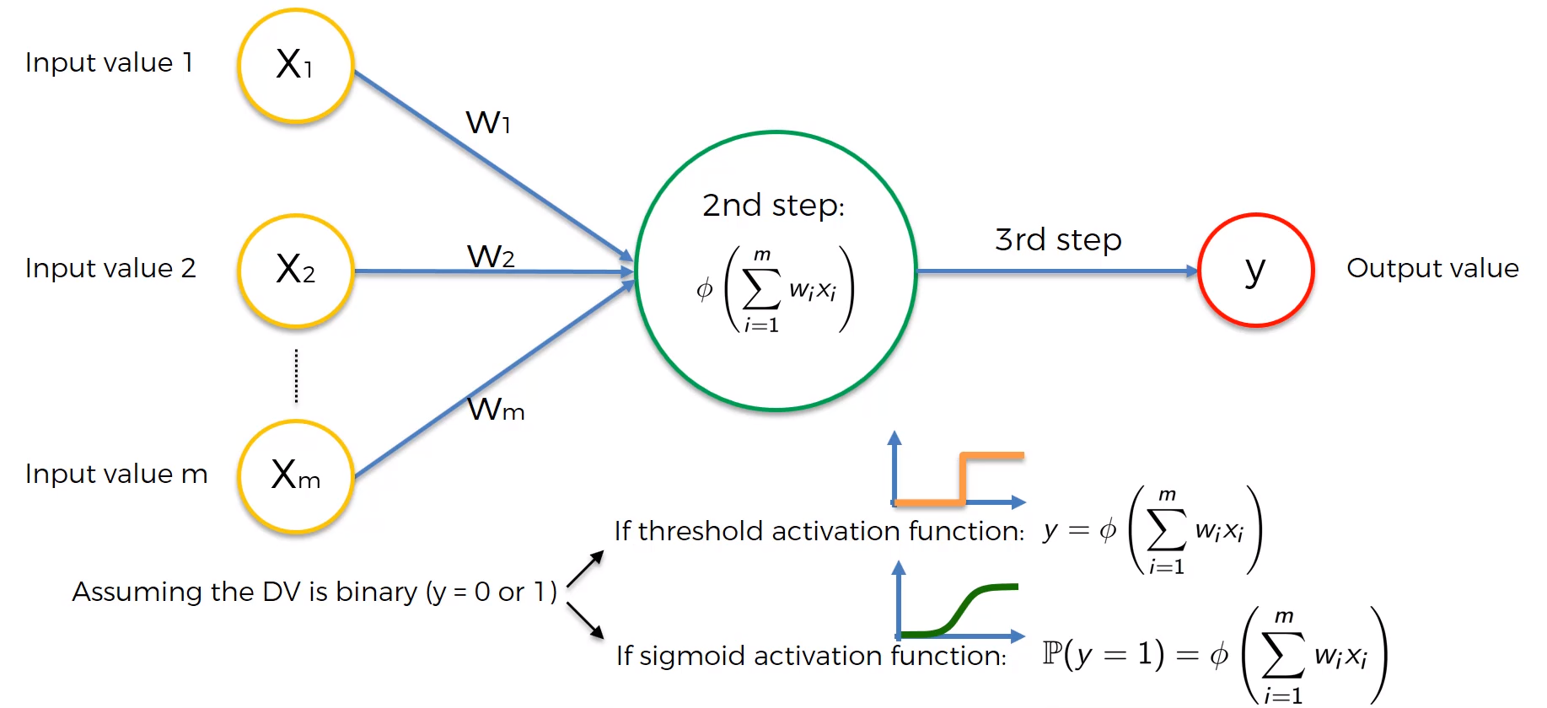
The Activation Function?
Notes:
For categorical, you will have multiple outputs.

Slide 13
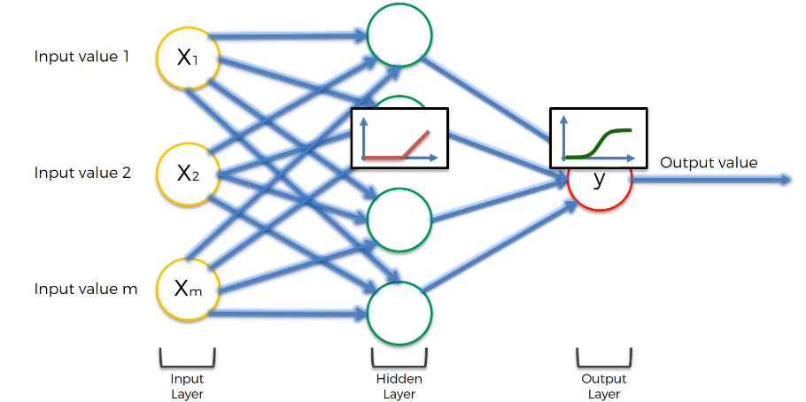
The Activation Function
Notes:
For categorical, you will have multiple outputs.

Slide 14
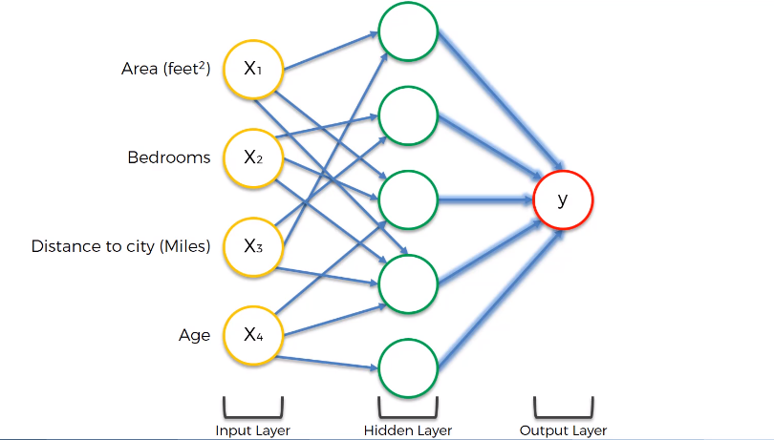
How do Neural Network Work?
Notes:
For categorical, you will have multiple outputs.

Slide 15
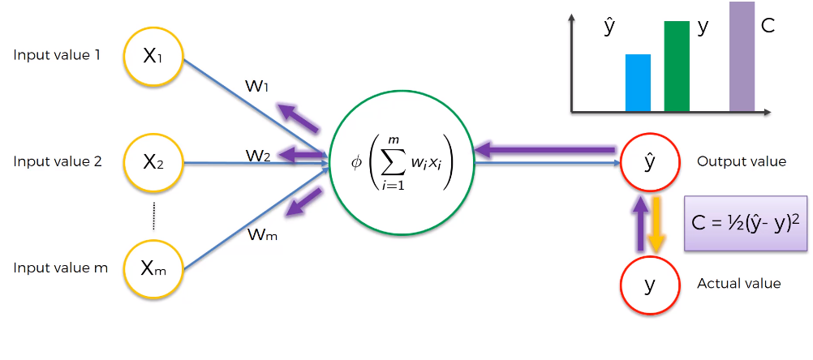
How do Neural Network Work?
Notes:
This is for one row

Slide 16
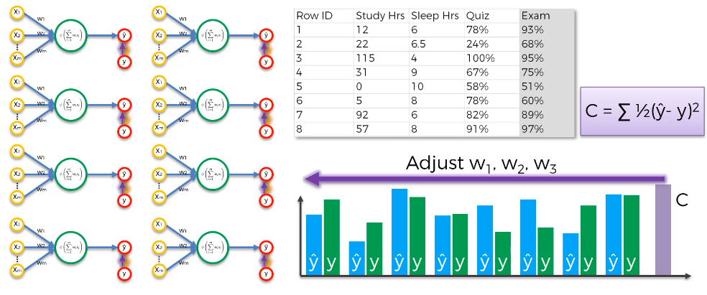
Stochastic Gradient Descent
Notes:
Whole process is called back propagation

Slide 17
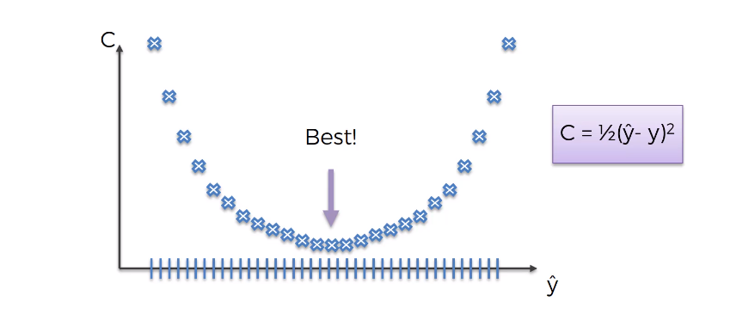
Gradient Descent

Slide 18
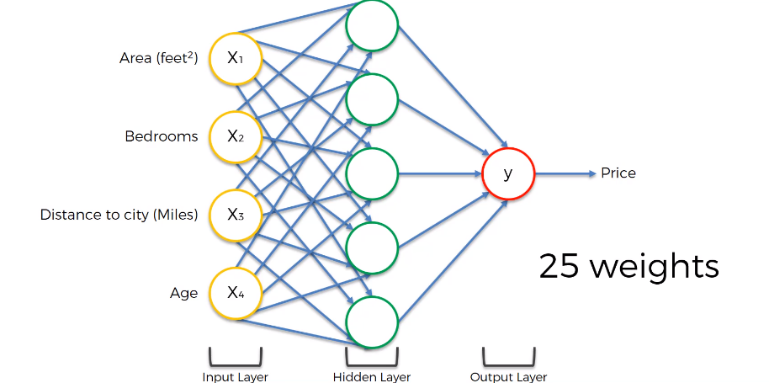
Gradient Descent

Slide 19
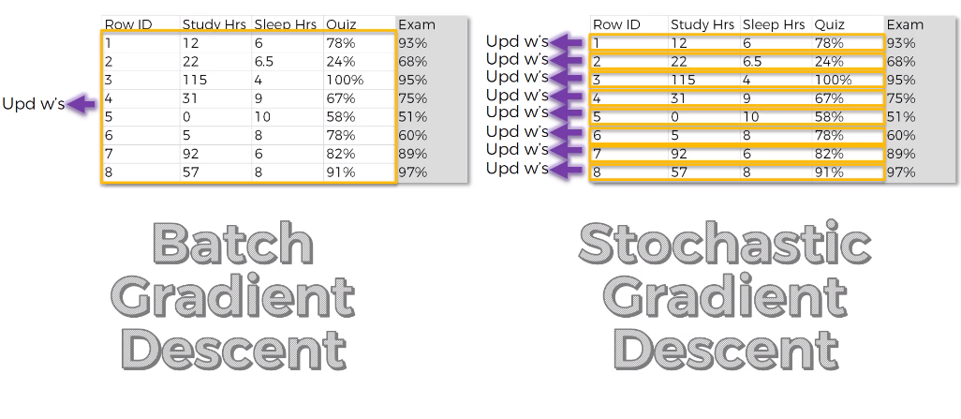
Stochastic Gradient Descent
http://iamtrask.github.io/2015/07/27/python-network-part2/

Slide 20
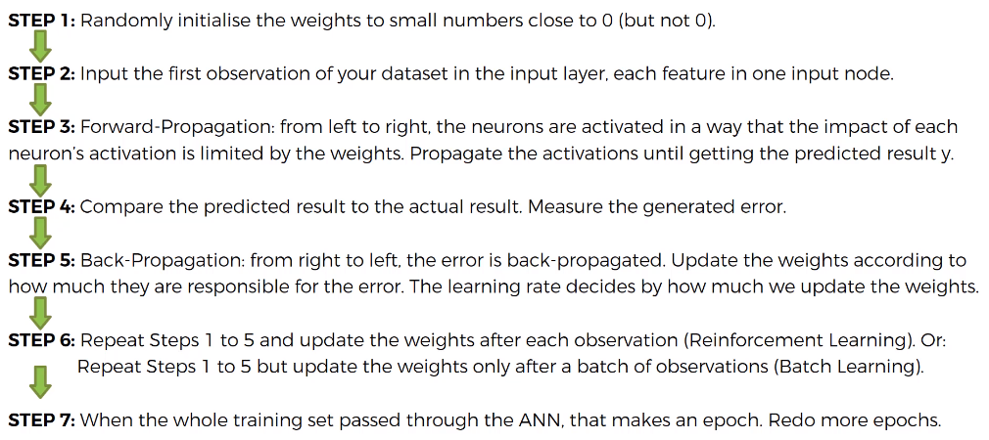
Training ANN with SGD

Slide 21
Install Keras
conda install -c conda-forge keras

Slide 22
Forward & Backward Propagation
Forward Propagation: Input data is transformed through activation function and output is calculated
Backward Propagation: Difference in actual and predicted outputs is passed backed to the neural network to adjust the weights
Batch: forward and backward propagation happens in terms of batches. One batch can be multiple number of input records
Epoch: The number of iterations entire train data is taken through forward and backward propagation to find out the global minima

